Slide 1

Angular Material
&
Beta 2.0.0-beta.8
Angular Flex-Layout

Slide 2

Angular Material
Website : https://material.angular.io/
GitHub : https://github.com/angular/material2
Current Version requires Angular 4.x.x
2.0.0-bate.2 – last version compatible with Angular 2.x.x

Slide 3
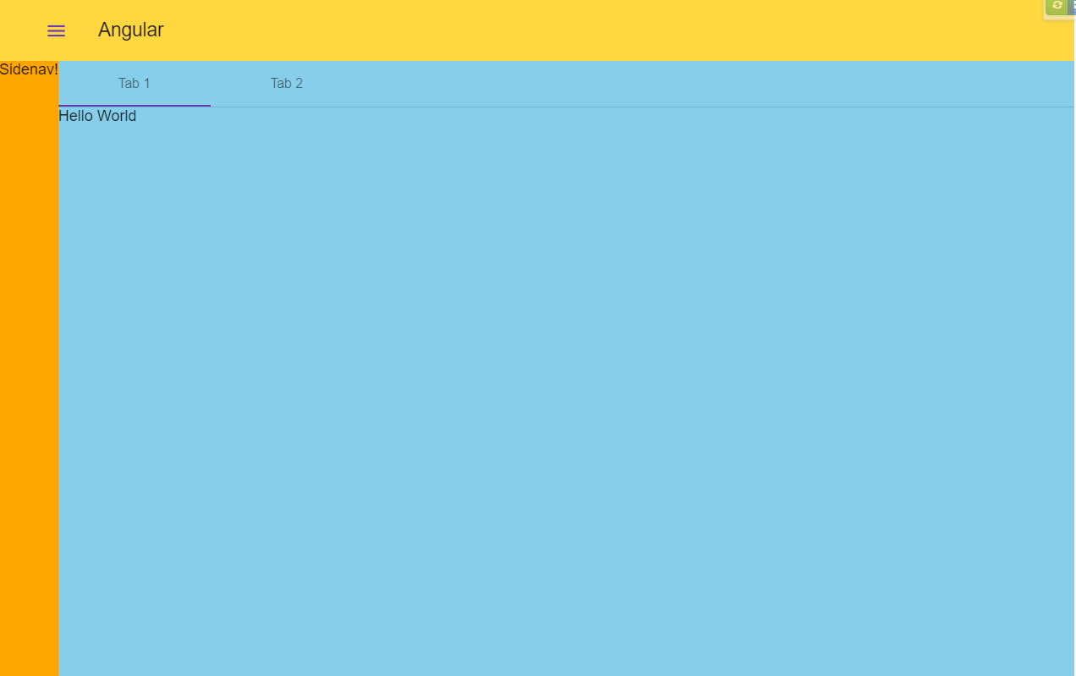
Demo
Plunker: https://plnkr.co/edit/EBSjqUIUka9koOCYoaU6

Slide 4
Angular Flex-Layout
Website : https://tburleson-layouts-demos.firebaseapp.com/#/docs
GitHub : https://github.com/angular/flex-layout
Current Version requires Angular 4.x.x
Beta.8 – last version compatible with Angular 2.4.x

Slide 5
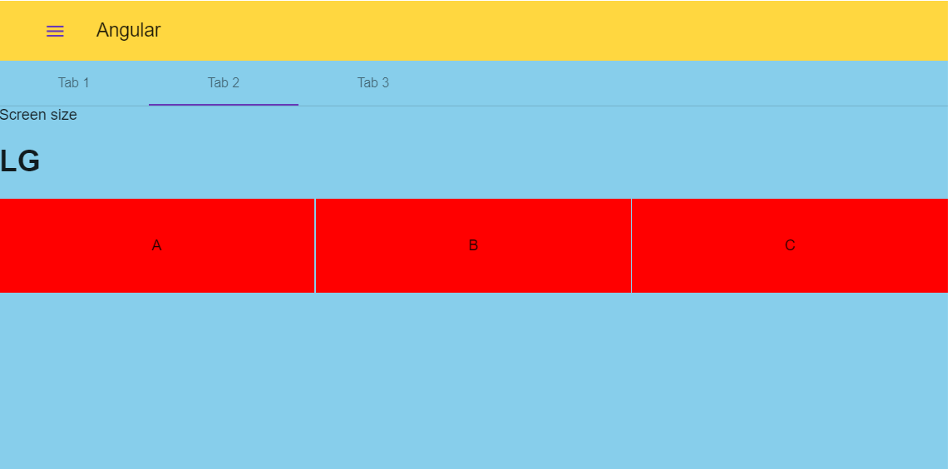
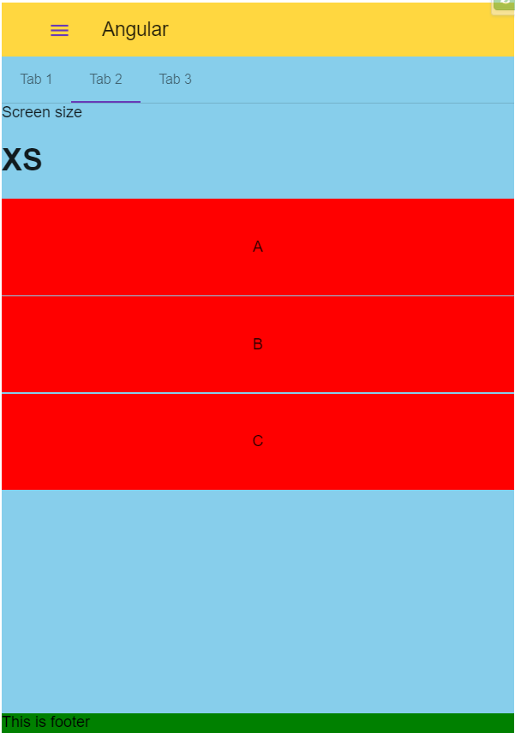
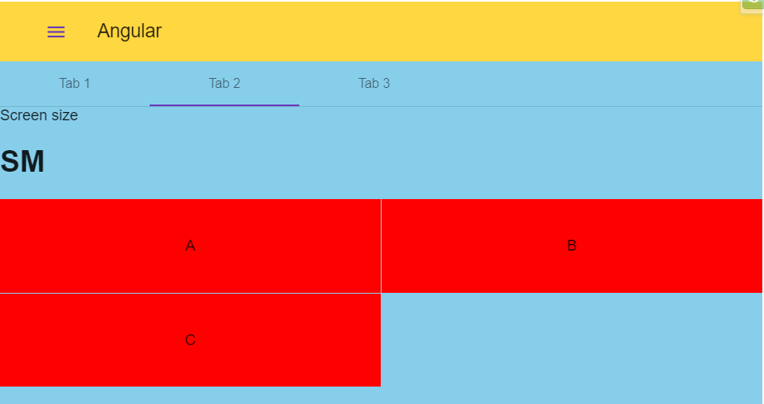
Demo
Plunker: https://plnkr.co/edit/a4iASMaZqQZNmuuQUapb?p=preview

Slide 6
The End

